Slide 1

AI Agents for the Optimization of
Thin-Shell Composite Booms
Federico Benazzo and Tara Venkatadri
Group Meeting Presentation
November 11th, 2026
Disclaimer: These slides were generated by Claude Opus 5.5 (Anthropic) based on an outline provided by the authors.
Notes:
Suggested presenters are in each slide's notes (edit as needed).

Slide 2

Background: LLMs and AI Agents
2
Large language models
Generate text one token at a time [1]
Plausible, not necessarily correct [1]
Good at code, poor at arithmetic
AI agents
Chatbots answer; agents pursue goals [1]
Act through tools, changing the state of their environment [1]
Useful when steps depend on results [1]
One token at a time [1]
Agent loop [1, 2]
Extract
the
yield
strength:
634
Thought
Action (tool call)
Observation
LLM
MPa
repeat until the goal is met
[1] Daraio, C. (2026). ME/CE/AM 295 Agentic AI in Scientific Discovery, lecture slides. Caltech.
[2] Yao, S., et al. (2023). ReAct: Synergizing reasoning and acting in language models. ICLR 2023.
Notes:
Suggested presenter: Tara.
Sources ([1] = ME 295 lecture slides): LLM box: 'one token at a time' = Lecture 3, slide 4; 'plausible, not necessarily correct' = Lecture 1, slide 16; 'good at code, poor at arithmetic' = Lecture 1, slide 14. Agent box: 'chatbots answer; agents pursue goals' = Lecture 2, slide 5; 'act through tools, changing the state of their environment' = Lecture 5, slide 12; 'useful when steps depend on results' = Lecture 10, slide 4. Token diagram = Lecture 3, slide 4. Agent loop = Lecture 5, slides 12-13, and Yao et al. 2023 (ReAct).
LLMs (left):
- An LLM generates text one token at a time: each pass reads the whole context and emits one token, which is appended before the next pass (Lecture 3). Example: after 'Extract the yield strength: 634' the next token is 'MPa'.
- It gives the most plausible continuation, not necessarily the correct one; it has no ground truth and cannot look anything up, compute or act unless given tools (Lecture 1).
- Reliable: writing and reviewing code, converting formats. Unreliable: multi-step arithmetic, property values, citations, knowing when it does not know (Lecture 1). So in our project the LLM writes code and makes design decisions, while every number comes from OpenSeesPy, Abaqus or the literature.
AI agents (right):
- 'A chatbot answers. An agent pursues a goal: it plans, it remembers, and it uses tools' (Lecture 2).
- Agent = LLM + planning + memory + tools, running a ReAct loop: thought, action (the model emits a tool call, code runs it), observation (the result comes back), repeat (Lecture 5; Yao et al. 2023).
- When it helps (Lecture 10): an agent is worth its cost (~4x the tokens of a chat) when there is a decision that depends on the last result and the path cannot be written in advance.
- Agentic is not autonomous: we stay responsible for specifying and verifying the result (Lecture 1).

Slide 3
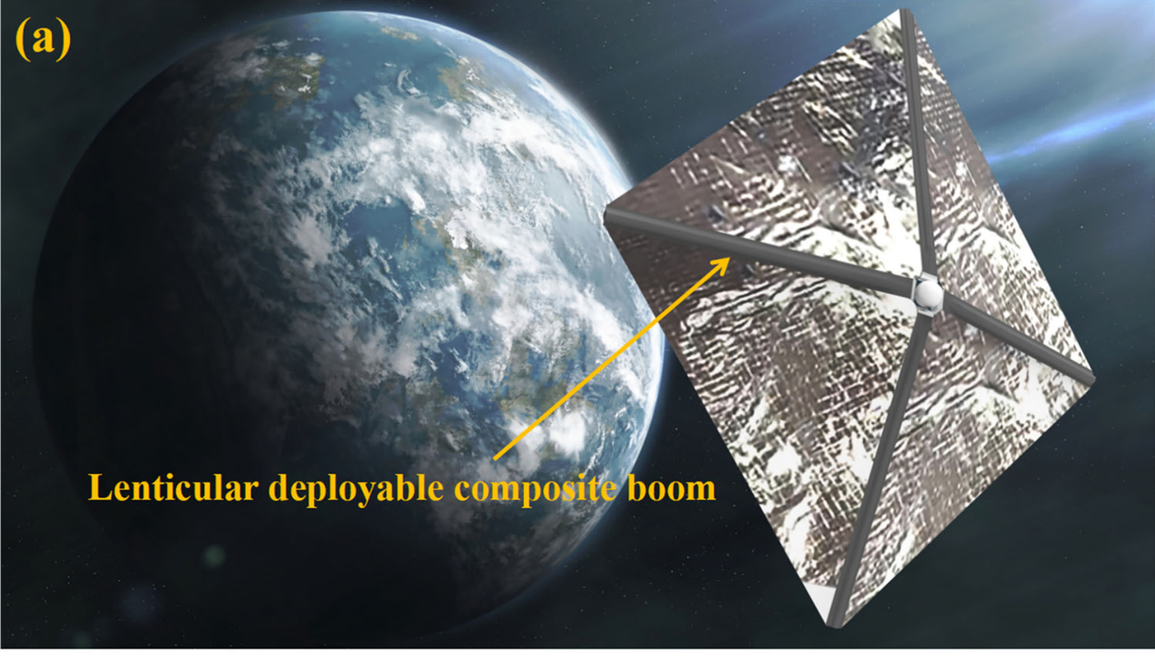
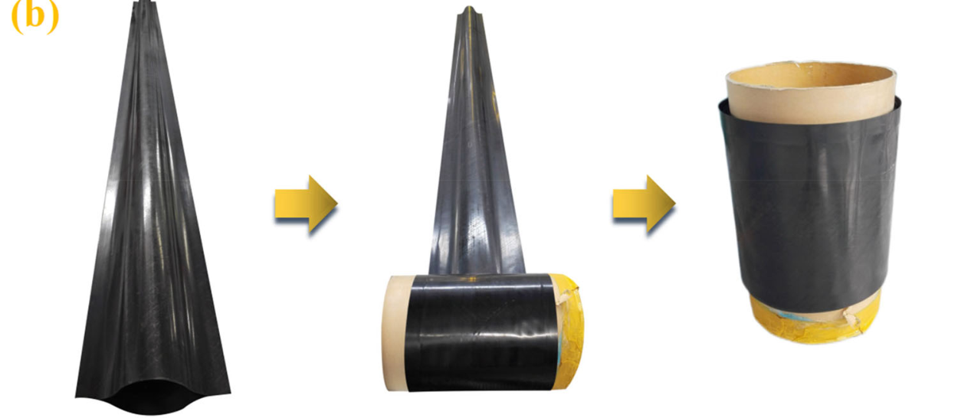
Designing Coilable Booms is Difficult
3
Lenticular composite boom [6]
Booms deploy solar arrays, antennas, sails [3, 4]
Many cross-sections, each suited to different missions [5]
Loads: Bending, buckling, coiling, folding
Coupled design variables:
Material and layup: Discrete
Cross-section geometry: Continuous
Goal: Lightest design that meets requirements without failing
[3] Murphey, T. W., et al. (2015). High strain composites. 2nd AIAA Spacecraft Structures Conference, AIAA 2015-0942.
[4] Fernandez, J. M. (2017). Advanced deployable shell-based composite booms for small satellite structural applications including solar sails. ISSS 2017.
[5] Murphey, T. W., et al. (2026). Performance comparison of flattenable and rollable booms. AIAA SciTech 2026 Forum, AIAA 2026-0802.
[6] Liu, T.-W., et al. (2023). Folding behavior of the thin-walled lenticular deployable composite boom. Mech. Adv. Mater. Struct., 30(11).
Notes:
Suggested presenter: Federico.
- Thin-shell CFRP booms deploy solar arrays, antennas and solar sails (Puig 2010; Murphey 2015; Fernandez 2017). The cross-section flattens, so multi-meter booms coil around a hub into ~100 mm diameter x 100 mm height (Fernandez 2017).
- Many cross-sections (tape spring, TRAC, omega/lenticular, corrugated), each with advantages and disadvantages depending on mission requirements (Murphey et al., SciTech 2026).
- Loads: bending, torsion, buckling, coiling around a hub, folding.
- Material (fiber + matrix) and layup are discrete choices; cross-section geometry is continuous. Objective: minimize mass (and packaged volume) without material failure while meeting stiffness and buckling requirements.
- Figure (Liu et al. 2023): (a) lenticular booms supporting a solar sail; (b) flattening and coiling.

Slide 4
Why a Team of AI Agents?
4
Existing optimizers
Geometry of one cross-section [6]
Chatbot alone
Cannot compute FE responses [7]
Fixed script
Each design needs a new FE model
Repeated decisions after each FE analysis → agent loop
Sandboxed on Amazon WorkSpaces without Abaqus: OpenSeesPy runs FEA in Python [8]
Agents write and run OpenSeesPy reliably [7, 9]
Gap: No LLM agents for optimizing thin-shell composites in OpenSeesPy
[6] Liu, T.-W., et al. (2023). Folding behavior of the thin-walled lenticular deployable composite boom. Mech. Adv. Mater. Struct., 30(11).
[7] Liu, J., et al. (2026). A large language model-empowered agent for reliable and robust structural analysis. Struct. Infrastruct. Eng.
[8] Zhu, M., et al. (2018). OpenSeesPy: Python library for the OpenSees finite element framework. SoftwareX, 7, 6-11.
[9] Zhang, Z., et al. (2026). LLM agent framework for structural steel design. Proc. Annual Stability Conference, SSRC.
Notes:
Suggested presenter: Tara.
- Existing optimizations: many-objective genetic algorithm (NSGA-III) on the cross-section geometry of a lenticular boom (Liu et al. 2023), a data-driven framework for the same boom (Sun et al. 2024), neural-network surrogates trained on FE of one collapsible-mast geometry (Palmeri & Laurenzi 2024). They optimize a few geometric parameters of one cross-section, not material, layup or cross-section type. Changing the material changes how buckles form and causes convergence difficulties (Luo & Pellegrino 2022).
- Conventional optimizers (e.g. fmincon) handle continuous geometry, but materials and practical layups are discrete, categorical choices.
- Chatbot alone: each design's response must be computed with FE, not estimated (Liu et al. 2026: LLM accuracy on beam problems drops away from canonical cases).
- Fixed script: each geometry (mesh), material/layup and load case needs a different OpenSeesPy model; by hand, each model takes a few hours, and analyzing it and choosing the next design another 1-2 hours.
- The design needs repeated decisions after each analysis: an agent loop. Liu et al. 2026: reliability improves greatly when the task is reframed as writing and running OpenSeesPy code. Zhang et al. 2026: agent team writes, runs and validates OpenSeesPy programs for steel design. Ni & Buehler 2024: agent teams write and correct FE code.
- Gap: no study combines LLM agents, OpenSeesPy and thin-shell composite optimization (OpenSeesPy: Zhu et al. 2018).

Slide 5
Proposed Solution: Agent System
5
Agent (LLM)
Tool
Library
Human
Code run
Librarian agent
Permissions split: Only agent with web access
Materials
Layups
Cross-sections
User input
Optimization orchestrator agent
User output
User reviews comparison
Ply/layup code
Mesh code
Load/BC code
Abaqus translator
Information split: Sees only outputs
Aggregator: One standalone script
Script → lab server
Results comparison agent
OpenSeesPy run
Abaqus run
Extract → workspace
Objective/constraints
Visualizer
Notes:
Suggested presenter: Tara.
What to say: three LLM agents (red) make the decisions that need judgment; deterministic tools (blue) generate, run and post-process the finite element models.
- The librarian searches the literature to fill three catalogs: lamina properties, layups, cross-sections.
- The user gives the cross-section class, BCs and loading, objective and constraints. The orchestrator chooses a material/layup/geometry and calls the code generators (ply/layup, mesh, load/BC); the aggregator joins them into one standalone OpenSeesPy script, the script runs, and the objective/constraint calculator (with the Hashin failure check) and the visualizer report back. The orchestrator decides the next design and stops at diminishing returns.
- Every few runs, or after large jumps in the objective/constraints, the orchestrator starts verification: the translator writes an Abaqus script, we run it on a lab server, the ODB extract comes back, and the results comparison agent compares both runs. We review the comparison and adjust the orchestrator.
Why separate agents (Lecture 10 split test: a second agent buys a separate context, so it needs a reason):
- PERMISSIONS: the librarian is the only agent allowed to search and fetch from the Internet; the orchestrator and the comparison agent have no web tools.
- INFORMATION: the comparison agent sees only the outputs of the OpenSeesPy and Abaqus runs, never the code that built the models, because the agent that verifies a model should not be the one that created it.
- Steps a script can do are tools (Claude Code skills), not agents.

Slide 6
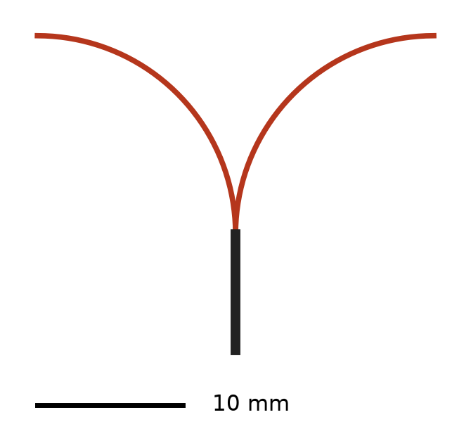
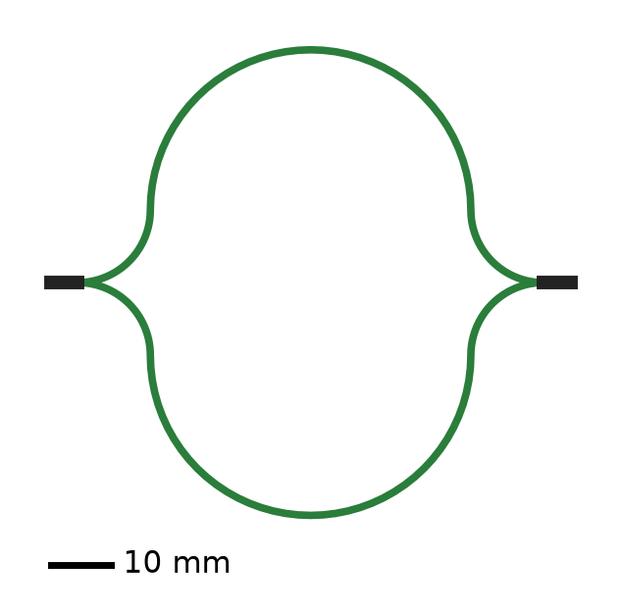
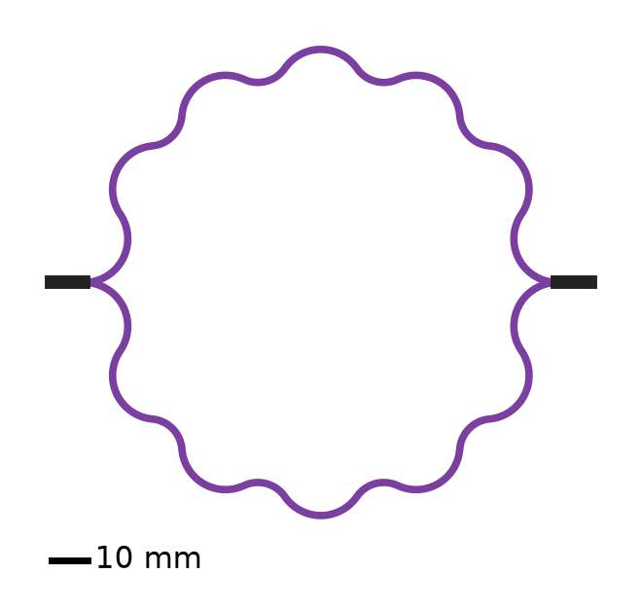
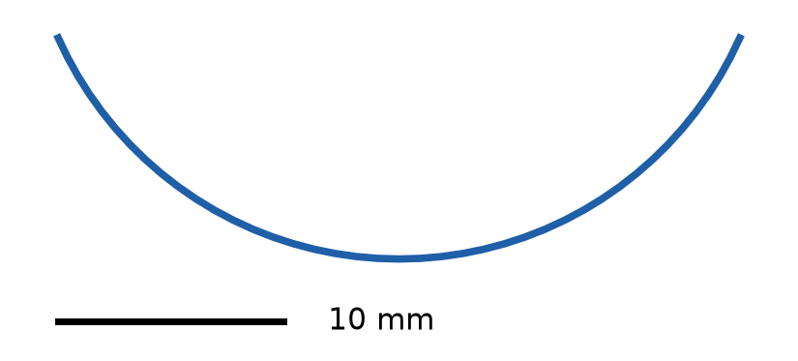
Librarian Agent and Catalogs
6
Only agent with web access: Builds three catalogs, each row with a source
Materials
38 laminae: Stiffness, strength, density
Layups
199 symmetric layups, 3-5 plies
Cross-sections
Literature values of geometric parameters for 4 boom types
Tape spring
TRAC [10]
Omega
Corrugated [11]
[10] Benazzo, F., & Pellegrino, S. (2025). Design and manufacturing of ultra-thin thermoplastic composites for coilable longerons. AIAA SciTech 2025 Forum.
[11] Fernandez, J. M., & Volle, C. E. (2021). Corrugated rollable tubular booms. AIAA SciTech 2021 Forum (NASA NTRS 20205003429).
Notes:
Suggested presenter: Federico (built the catalogs on 11/4).
- The librarian is the only agent with WebSearch/WebFetch. It searches NCAMP/NASA qualification reports, peer-reviewed papers (WWFE data sets) and manufacturer datasheets; every row has a source; estimates are marked *.
- Materials: 38 UD laminae (L001-L038): carbon, glass, basalt, flax fibers; epoxy and thermoplastic (PEEK, LM-PAEK, PPS) matrices; E1, E2, G12, nu12, nu23, G23, Xc, Xt, Yc, Yt, S12, ply thickness, density. A script checks every row. Ply thickness set to 0.035 mm for all rows (project decision 11/5).
- Layups: 199 symmetric layups (Y001-Y199) of 3-5 plies, angles 0, +-30, +-45, +-60, 90 deg, at least one 0 ply.
- Cross-sections: 100 geometries, 25 each of tape springs, TRAC, omega/lenticular and corrugated booms, from the literature, derived from it, or designed within published ranges; checked to flatten, with tangent arcs and no self-intersection.
- Drawings are made from catalog rows T013, R011 (Benazzo & Pellegrino 2025), M008 (NASA CTM) and C006 (Fernandez & Volle 2021); black = bonded web.

Slide 7
Optimization Orchestrator Agent
7
1
Read requirements from prompt
Tools it calls (skills)
Ply/layup, mesh, load/BC code
Aggregator and run
Visualizer
Hashin failure check [12]
Buckling
Objective/constraints
Abaqus translator
2
Screen all catalog combinations
3
Choose material, geometry, layup
4
Build, run and plot FE model
5
Check failure, coiling, buckling
Guardrails
Fixed step order, blocked actions
6
Mass and constraints → next design
Up to 100 iterations, 5-10 Abaqus checks
[12] Hashin, Z. (1980). Failure criteria for unidirectional fiber composites. J. Appl. Mech., 47(2), 329-334.
Notes:
Suggested presenter: Federico (built v3.0 on 11/5).
- Started with /design-boom and the requirements prompt (bending stiffness in a direction, buckling strength under a load, coiling/hub radius, length, limits). It asks for anything missing.
- Screening (design_screen.py): ranks all catalog material x layup x geometry combinations (1.6 million, ~20 s) with closed forms: mass, beam stiffness, buckling estimates, exact CLT coiling index. The orchestrator picks from this ranked list instead of guessing.
- Each run: laminate (ABD check), assembled OpenSeesPy script, plots, Hashin failure + flattening check, buckling if required, objective (always minimize mass) and constraints (no failure, plus user constraints).
- Guardrails: PROTOCOL.md (permissions and ordered steps, read before every action); study.py refuses steps out of order, checks FE tip stiffness against thin-walled beam theory (15%), schedules mesh convergence and 5-10 Abaqus verifications, stops at diminishing returns or 100 iterations; a hook blocks forbidden actions (e.g. catalog edits) during a study.
- Tests on 11/5: 300 mm tape spring, 10 s per design, FE stiffness 1.7% from beam theory; buckling ~30 min per design.

Slide 8
Abaqus Verification Loop
8
Every few iterations or after large jumps in objective or constraints
Verifying agent is separate from the agent that built the model
Orchestrator calls translator tool
Translator writes Abaqus script
Abaqus run on a lab server
Results comparison agent
Sees: Outputs of both runs
Never sees: Code that built the models
Users review comparison, adjust orchestrator
ODB extract copied back
Notes:
Suggested presenter: Tara (built the translator skill and the comparison agent on 11/4).
- First version (Lab 2): one agent translated the model to Abaqus and also compared the results, which risks confirmation bias. Now translation is a skill called by the orchestrator, and a separate comparison agent sees only the outputs.
- When: every few iterations or after large jumps in the objective/constraints; the loop continues while we run Abaqus.
- Abaqus is not installed on the class workspace: we copy the script to a lab server, check the set-up in Abaqus/CAE, run it, extract the ODB to plain arrays (.npz) and copy the extract back.
- The comparison agent compares displacements, rotations, membrane strains, curvatures, ply stresses, section forces/moments and the load path. It may not read the skills, the OpenSeesPy script, the Abaqus script or the case files, and may not edit the comparison tools to make a comparison pass.

Slide 9
Test: Librarian Material Catalog
9
38 UD laminae with stiffness, strength, ply thickness and density
Every value from a cited source; estimates marked *
ID | Material | E₁ / E₂ / G₁₂ (GPa) | ν₁₂ | X_{t} / Y_{t} / S₁₂ (MPa) | X_{c} / Y_{c} (MPa) | t (mm) | ρ (g/cm³)
L001 | IM7/8552 [13] | 158.5 / 8.95 / 4.67 | 0.316 | 2501 / 64.0 / 91.1 | 1716 / 285.7 | 0.183 | 1.58
L002 | IM7/8552 [14] | 171.4 / 9.08 / 5.29 | 0.32 | 2326 / 62.3 / 92.3 | 1200 / 199.8 | 0.131 | 1.58
L013 | AS4/3501-6 [15] | 126 / 11 / 6.6 | 0.28 | 1950 / 48 / 79 | 1480 / 200 | NA | 1.58*
L024 | CFRP [6] | 80.1 / 6.67 / 2.93 | 0.344 | 1063 / 66.0 / 126.8 | 662.7 / 144.5 | 0.08 | 1.60
[6] Liu, T.-W., et al. (2023). Folding behavior of the thin-walled lenticular deployable composite boom. Mech. Adv. Mater. Struct., 30(11).
[13] NCAMP (2011). Hexcel 8552 IM7 unidirectional prepreg qualification material property data report, CAM-RP-2009-015 Rev. A.
[14] Camanho, P. P., et al. (2007). Prediction of size effects in notched laminates using continuum damage mechanics. CST, 67(13).
[15] Soden, P. D., et al. (1998). Lamina properties, lay-up configurations and loading conditions for a range of FRP laminates. CST, 58(7).
Notes:
Suggested presenter: Federico.
- Lab Report 2 (10/29): 37 UD laminae, 25 with the complete stiffness and strength data needed for the laminate model and the failure check (orange columns, Table I of the report).
- The librarian was then updated to also search for density, thickness, nu23, G23 and compressive strengths: 38 laminae with every column filled (blue columns show the values it found for the same sources).
- * = estimate (density by rule of mixtures). L002 density: not in Camanho 2007, NCAMP IM7/8552 value used. Not shown: nu23, G23 (L001 0.45*/3.09*, L002 0.45*/3.13*, L013 0.4/3.93*, L024 0.33*/2.50 GPa).
- t is the ply thickness in each source; the catalog now sets every ply to 0.035 mm (project decision, 11/5).

Slide 10
Test: Layup Generator, [0/90/90/0]
10
Generated OpenSeesPy code (abridged)
Classical laminate theory
ops.nDMaterial('ElasticOrthotropic', 2, 139500.0,
6101.0, 6101.0, 0.275, 0.275, 0.0120,
2574.0, 2392.5, 2574.0, 0.0)
ops.nDMaterial('PlaneStress', 3, 2)
ops.nDMaterial('PlateFromPlaneStress', 4, 3, 2574.0)
ops.section('LayeredShell', 1, 32, 4, 0.00675, ...)
ops.section('LayeredShell', 2, 32, 1, 0.00675, ...)
A (N/mm)
D (N·mm)
15780
363.6
0
103.5
1.414
0
363.6
15780
0
1.414
19.19
0
0
0
556.0
0
0
2.162
OpenSeesPy vs. classical laminate theory
A, B: Exact match
D: Within 0.3%
OpenSeesPy
A (N/mm)
D (N·mm)
15777
363.6
0
103.4
1.412
0
363.6
15777
0
1.412
19.13
0
0
0
556.0
0
0
2.160
Notes:
Suggested presenter: Tara.
- Ply: E1 = 139.5 GPa, E2 = 6.101 GPa, G12 = 2.574 GPa, nu12 = 0.275, t = 54 um per ply (h = 0.216 mm).
- The laminate-properties skill writes the OpenSeesPy material chain (ElasticOrthotropic -> PlaneStress -> PlateFromPlaneStress) and one LayeredShell section per ply angle, 8 sub-layers per ply; plies with the same angle share a coincident ASDShellQ4 element.
- The ABD the OpenSees element actually sees is measured on one facet with imposed strains and compared with the hand (CLT) values. A matches (differences only from the 4-digit rounding of the hand values); B = 0 in both (symmetric); D is 0.06-0.3% low because LayeredShell integrates each sub-layer at its mid-plane.
- Hand values converted from GPa*um (A x 10^4) and GPa*um^3 (D x 10^8) to N/mm and N*mm.

Slide 11
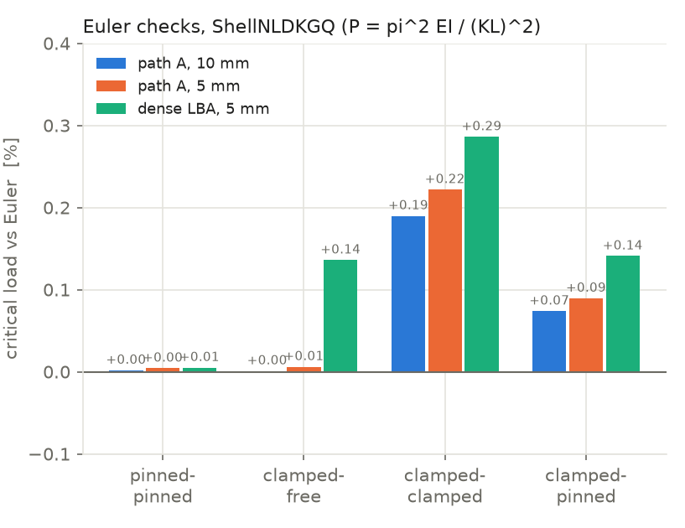
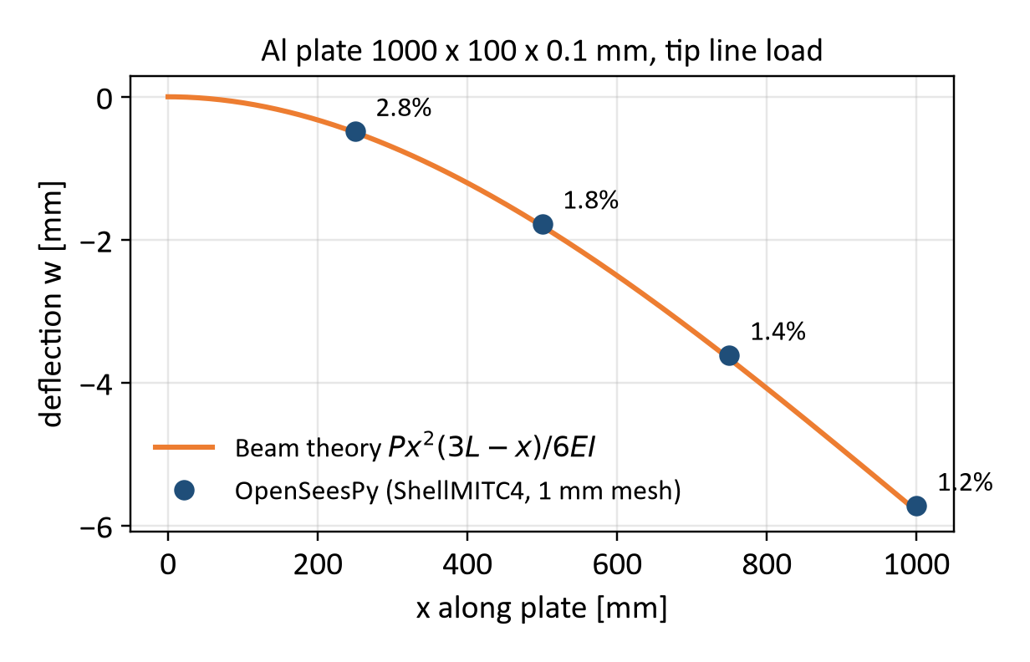
Test: Mesh/Load/BC Generator, Aluminum
11
Buckling: Al strip 500 × 10 × 1 mm
Bending: Al plate 1000 × 100 × 0.1 mm
Within 0.3% of Euler load
Within 3% of beam theory
Notes:
Suggested presenter: Federico (10/22 plate tests, 10/29 buckling study).
- Buckling: Al strip 500 x 10 x 1 mm in compression through rigid end fixtures, four end conditions. Critical load from the zero crossing of the lowest tangent-stiffness eigenvalue along the nonlinear path (ShellNLDKGQ) and from a dense linear buckling analysis: within 0.3% of Euler P = pi^2 EI/(KL)^2 for all four, 10 and 5 mm meshes.
- Linear bending: Al cantilever plate 1000 x 100 x 0.1 mm (E = 69 GPa), tip line load, 1 x 1 mm ShellMITC4 mesh, 606,000 DOFs, 28 s. Deflection within 1.2-2.8% of beam theory (FE stiffer: the clamp restrains anticlastic curvature); bending stress within 0.06% of Mc/I.
- Large deflection (not shown): corotational ASDShellQ4 within 0.2-2% of the elastica with EI/(1-nu^2), up to a tip drop of 75% of the length.

Slide 12
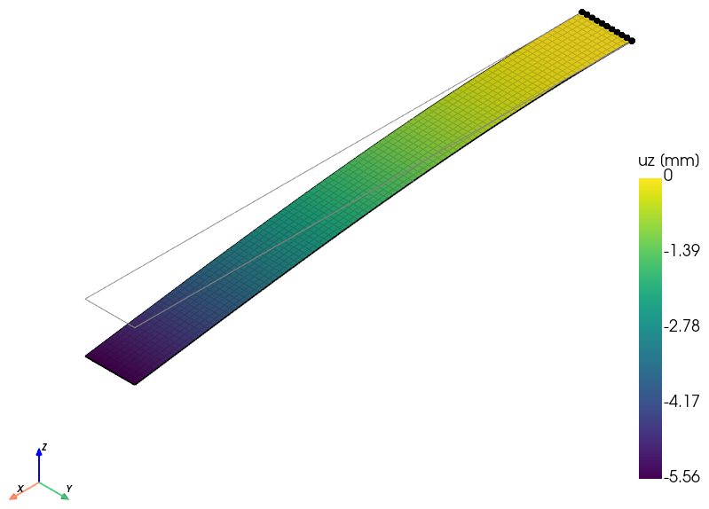
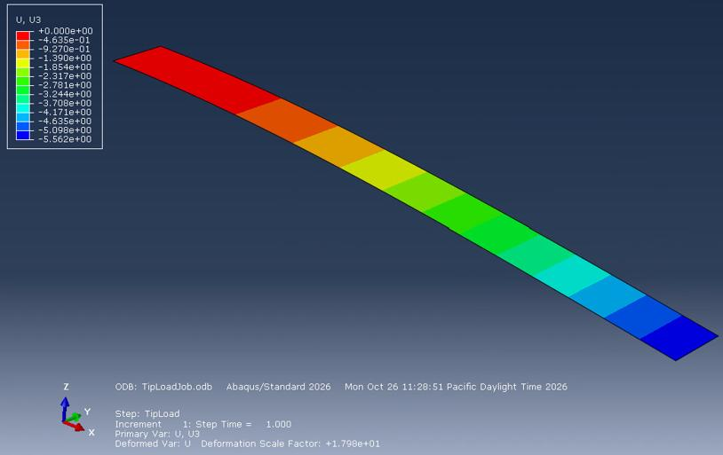
Test: [0₂/90₂]s Plate, OpenSeesPy vs. Abaqus
12
OpenSeesPy z-displacement (mm)
Abaqus (translated script) U3 (mm)
Tip deflection (mm) | OpenSeesPy | Abaqus | Beam theory
5 N tip load | −5.563 | −5.562 | −5.554
Agree within 0.02%
Notes:
Suggested presenter: Tara.
- Combined test of the layup, mesh and load/BC generators: ply E1 = 80 GPa, E2 = 2 GPa, G12 = 1 GPa, nu12 = 0.25, 1 mm plies (h = 8 mm); plate 1000 x 100 mm, clamped at x = 0, tip load P = 5 N (-z) along the free edge; 10 mm ASDShellQ4 mesh; linear. The code pieces were joined into one standalone OpenSeesPy script and run.
- OpenSeesPy tip deflection -5.563 mm: within 0.17% of laminated beam theory (-5.554 mm), 0.03% with transverse shear; top-surface stress within 0.06% of CLT.
- The OpenSeesPy-to-Abaqus translator converted the model into an Abaqus/CAE Python script (composite shell section, S4R, encastre root, edge load at the tip). It was run on a lab server and the set-up was checked in the Abaqus interface: tip deflection -5.562 mm, within 0.02% of OpenSeesPy. So we are confident that the OpenSeesPy code works as intended. Both plots: deformation x18.

Slide 13
Sample Optimization: Problem
13
Prompt given to the orchestrator (11/6)
Requirements
[Placeholder: Verbatim /design-boom prompt of 11/6]
Minimize mass
Tape spring, length [ ]
Tip displacement ≤ [ ]
Buckling load ≥ [ ]
Coils on hub of radius [ ]
No material failure
Notes:
Suggested presenter: Federico. PLACEHOLDER: paste the verbatim 11/6 prompt and fill in the requirement values.

Slide 14
Sample Optimization: Optimal Design
14
Design variable | Optimal value
Material | [ ]
Layup | [ ]
Cross-section | [ ]
Mass | [ ]
Mass vs. iteration
[Placeholder: Mass vs. iteration, feasible and infeasible designs]
Constraint | Value | Limit
Tip displacement | [ ] | [ ]
Buckling load | [ ] | [ ]
Coiling Hashin index | [ ] | < 1
Hashin index | [ ] | < 1
Notes:
Suggested presenter: Federico. PLACEHOLDER: to be filled from the study REPORT.md once the optimization finishes (iterations, Abaqus verifications, mesh convergence, stopping reason).

Slide 15
Sample Optimization: Behavior
15
Bending
Buckling
Coiling
[Placeholder: Deformed shape]
[Placeholder: Buckling mode and load path]
[Placeholder: Coiling Hashin index]
[key result]
[key result]
[key result]
Notes:
Suggested presenter: Federico. PLACEHOLDER: shell-visualize, shell-buckling and failure-check outputs of the final design: bending (deformed shape), buckling (mode and load path), folding/coiling (Hashin index).

Slide 16
Conclusion
16
Summary
Built a team of AI agents that optimizes thin-shell composite booms
Three agents where needed, deterministic tools elsewhere
Catalogs: 38 materials, 199 layups, 100 cross-sections
OpenSeesPy tools match hand calculations, theory and Abaqus
[Placeholder: Result of the first optimization]
Notes:
Suggested presenter: Tara.
- Agents only where earned: librarian (permissions: web access), orchestrator, results comparison agent (information: sees only outputs). Everything a script can do is a deterministic tool (skill).
- Catalogs: 38 UD laminae, 199 layups, 100 cross-sections, all with sources.
- The OpenSeesPy tools were verified against hand ABD calculations, beam theory, the Euler buckling load and Abaqus (0.02% on the laminated plate).
- The orchestrator v3.0 ran two test studies on 11/5; the first full tape-spring optimization (prompt of 11/6) is running.

Slide 17
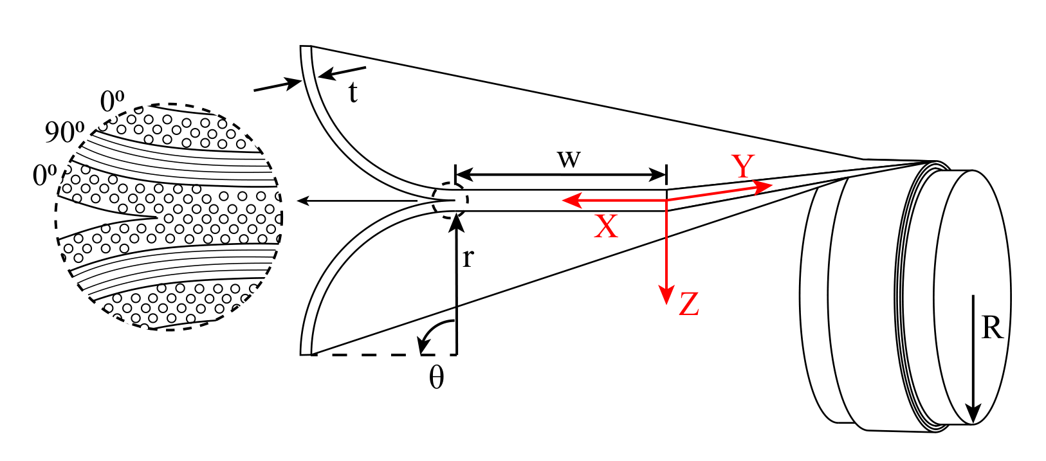
Future Work
17
Cross-sections
TRAC, omega, corrugated
Load cases
Coiling with contact
Abaqus
Automate runs on lab servers
TRAC [10]
Lenticular (omega) [6]
Corrugated [11]
[6] Liu, T.-W., et al. (2023). Folding behavior of the thin-walled lenticular deployable composite boom. Mech. Adv. Mater. Struct., 30(11).
[10] Benazzo, F., & Pellegrino, S. (2025). Design and manufacturing of ultra-thin thermoplastic composites for coilable longerons. AIAA SciTech 2025 Forum.
[11] Fernandez, J. M., & Volle, C. E. (2021). Corrugated rollable tubular booms. AIAA SciTech 2021 Forum (NASA NTRS 20205003429).
Notes:
Suggested presenter: Tara.
- Cross-sections: shell-mesh cannot yet build TRAC double-thickness webs or closed omega/corrugated sections; a separate session is extending it. Images: TRAC (Benazzo & Pellegrino 2025, Fig. 1), lenticular/omega boom folding (Liu et al. 2023, Fig. 1b), corrugated boom drawn from catalog row C006 (geometry from Fernandez & Volle 2021).
- Load cases: coiling around a hub with contact, folding.
- Abaqus: today we copy each Abaqus script to a lab server, run it and copy the ODB extract back by hand; next we will automate these runs on the lab servers.

Slide 18
References
18
[1] Daraio, C. (2026). ME/CE/AM 295 Agentic AI in Scientific Discovery, lecture slides. Caltech.
[2] Yao, S., et al. (2023). ReAct: Synergizing reasoning and acting in language models. ICLR 2023.
[3] Murphey, T. W., et al. (2015). High strain composites. 2nd AIAA Spacecraft Structures Conference, AIAA 2015-0942.
[4] Fernandez, J. M. (2017). Advanced deployable shell-based composite booms for small satellite structural applications including solar sails. ISSS 2017.
[5] Murphey, T. W., et al. (2026). Performance comparison of flattenable and rollable booms. AIAA SciTech 2026 Forum, AIAA 2026-0802.
[6] Liu, T.-W., et al. (2023). Folding behavior of the thin-walled lenticular deployable composite boom. Mech. Adv. Mater. Struct., 30(11).
[7] Liu, J., et al. (2026). A large language model-empowered agent for reliable and robust structural analysis. Struct. Infrastruct. Eng.
[8] Zhu, M., et al. (2018). OpenSeesPy: Python library for the OpenSees finite element framework. SoftwareX, 7, 6-11.
[9] Zhang, Z., et al. (2026). LLM agent framework for structural steel design. Proc. Annual Stability Conference, SSRC.
[10] Benazzo, F., & Pellegrino, S. (2025). Design and manufacturing of ultra-thin thermoplastic composites for coilable longerons. AIAA SciTech 2025 Forum.
[11] Fernandez, J. M., & Volle, C. E. (2021). Corrugated rollable tubular booms. AIAA SciTech 2021 Forum (NASA NTRS 20205003429).
[12] Hashin, Z. (1980). Failure criteria for unidirectional fiber composites. J. Appl. Mech., 47(2), 329-334.
[13] NCAMP (2011). Hexcel 8552 IM7 unidirectional prepreg qualification material property data report, CAM-RP-2009-015 Rev. A.
[14] Camanho, P. P., et al. (2007). Prediction of size effects in notched laminates using continuum damage mechanics. CST, 67(13).
[15] Soden, P. D., et al. (1998). Lamina properties, lay-up configurations and loading conditions for a range of FRP laminates. CST, 58(7).

Slide 19
Thank you!
Questions?

